Slide 1
MTO Pavement Condition on Provincial Highways
Wentao Lu
Thien An Dao

Slide 2
Data Collection
Source: https://data.ontario.ca/en/dataset/pavement-condition-for-provincial-highways
Better understanding of road condition base on pavement type and the usage of it.

Slide 3
Data Collection
16 attributes in total
5 numeric
Continuous: PCI, DMI, IRI, From_Distance, To_Distance
11 categorical
Nominal: SectionID, Highway, Direction, LHRS, Offset, Pavement_Type, Latitude, Longitude, Pavement_Section_From, Pavement_Section_To, Function Class.

Slide 4
Preprocessing
Remove duplicates: 1828 entities to 1827
Add Distance attribute
Distance = To_Distance - From_Distance
Removed: Section ID, Highway, Direction, LHRS, Offset, Latitude, Longitude, Pavement_Section_From, Pavement_Section_To, Function Class

Slide 5
Preprocessing
 | Minimum | Maximum | Mean
Distance | 0.17 | 51.3 | 10.192
PCI | 24.08 | 98.87 | 78.382
DMI | 4.07 | 10 | 8.423
IRI | 0.54 | 6.73 | 1.576

Slide 6
Preprocessing
Pave_Type
FWY | 1422
LOC | 84
ART | 34
COL | 287
FUNC_CLASS
FWY | 625
LOC | 417
ART | 639
COL | 146

Slide 7
Analysis
kNN: k-nearest neighbor
Outlier: Unfamiliar detection
kMeans: Clustering/grouping
Regression: Prediction

Slide 8
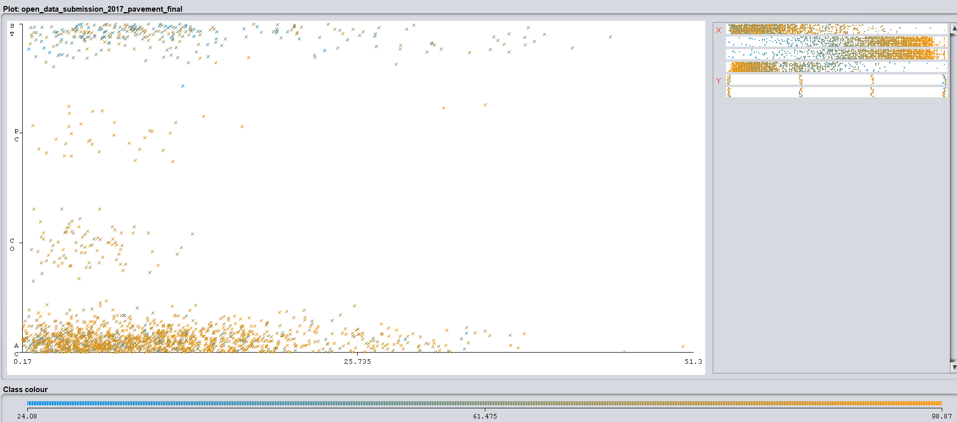
Result (Visualize)
Distance + Pave_Type => PCI

Slide 9
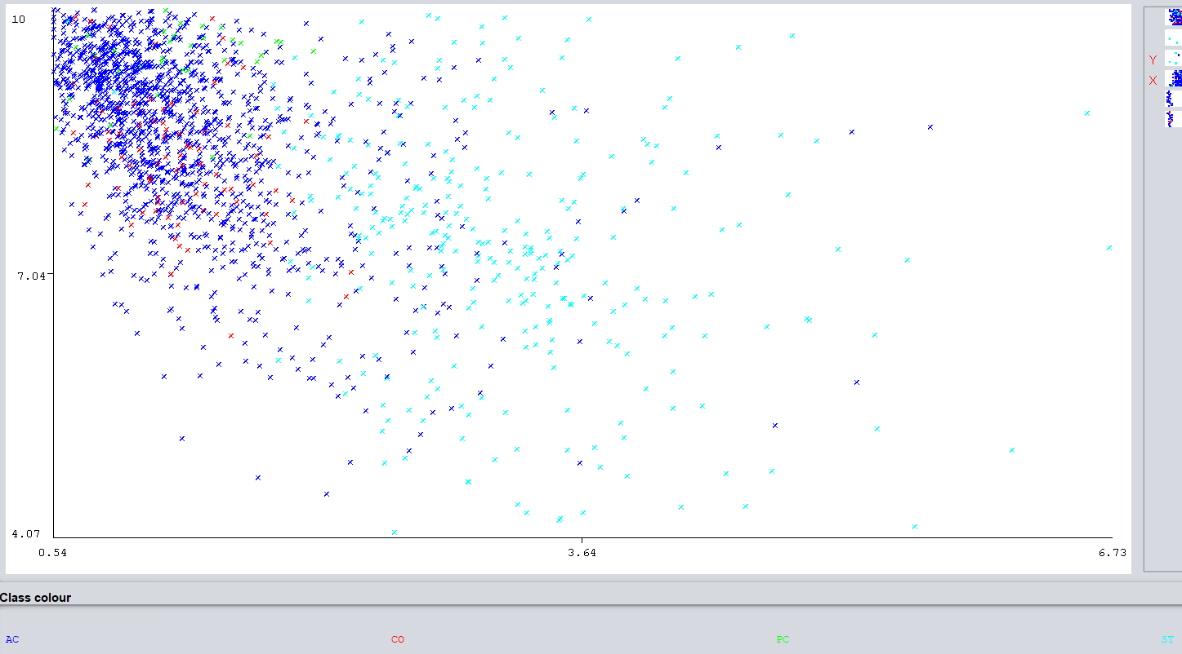
Result (Visualize)
IRI + DMI => Pave_Type

Slide 10
Conclusion (kNN)
Best kNN
k = 2
Correctly Classified Instances = 92.0088
Confusion Matrix:
a b c d <-- classified as
1397 6 0 19 | a = AC
69 15 0 0 | b = CO
14 1 19 0 | c = PC
37 0 0 250 | d = ST

Slide 11
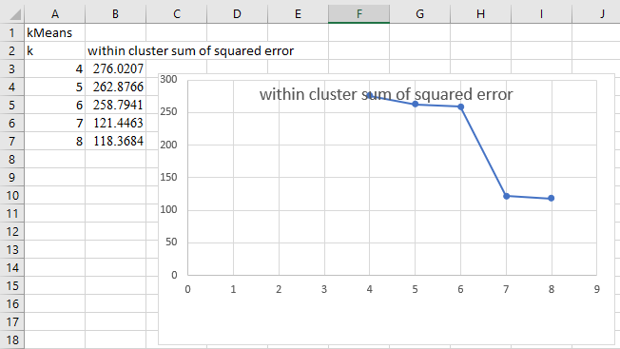
Result (kMeans)
Best k is 7

Slide 12
Result (Linear Regression)
PCI =
9.1237 * DMI +
-6.5139 * IRI +
-6.0409 * Pave_Type=CO,AC,PC +
2.0149 * Pave_Type=AC,PC +
-3.5341 * Pave_Type=PC +
0.2841 * FUNC_CLASS=ART,FWY +
0.2942 * FUNC_CLASS=FWY +
15.0539
=> DMI has the most positive influence & IRI has the most negative influence

Slide 13
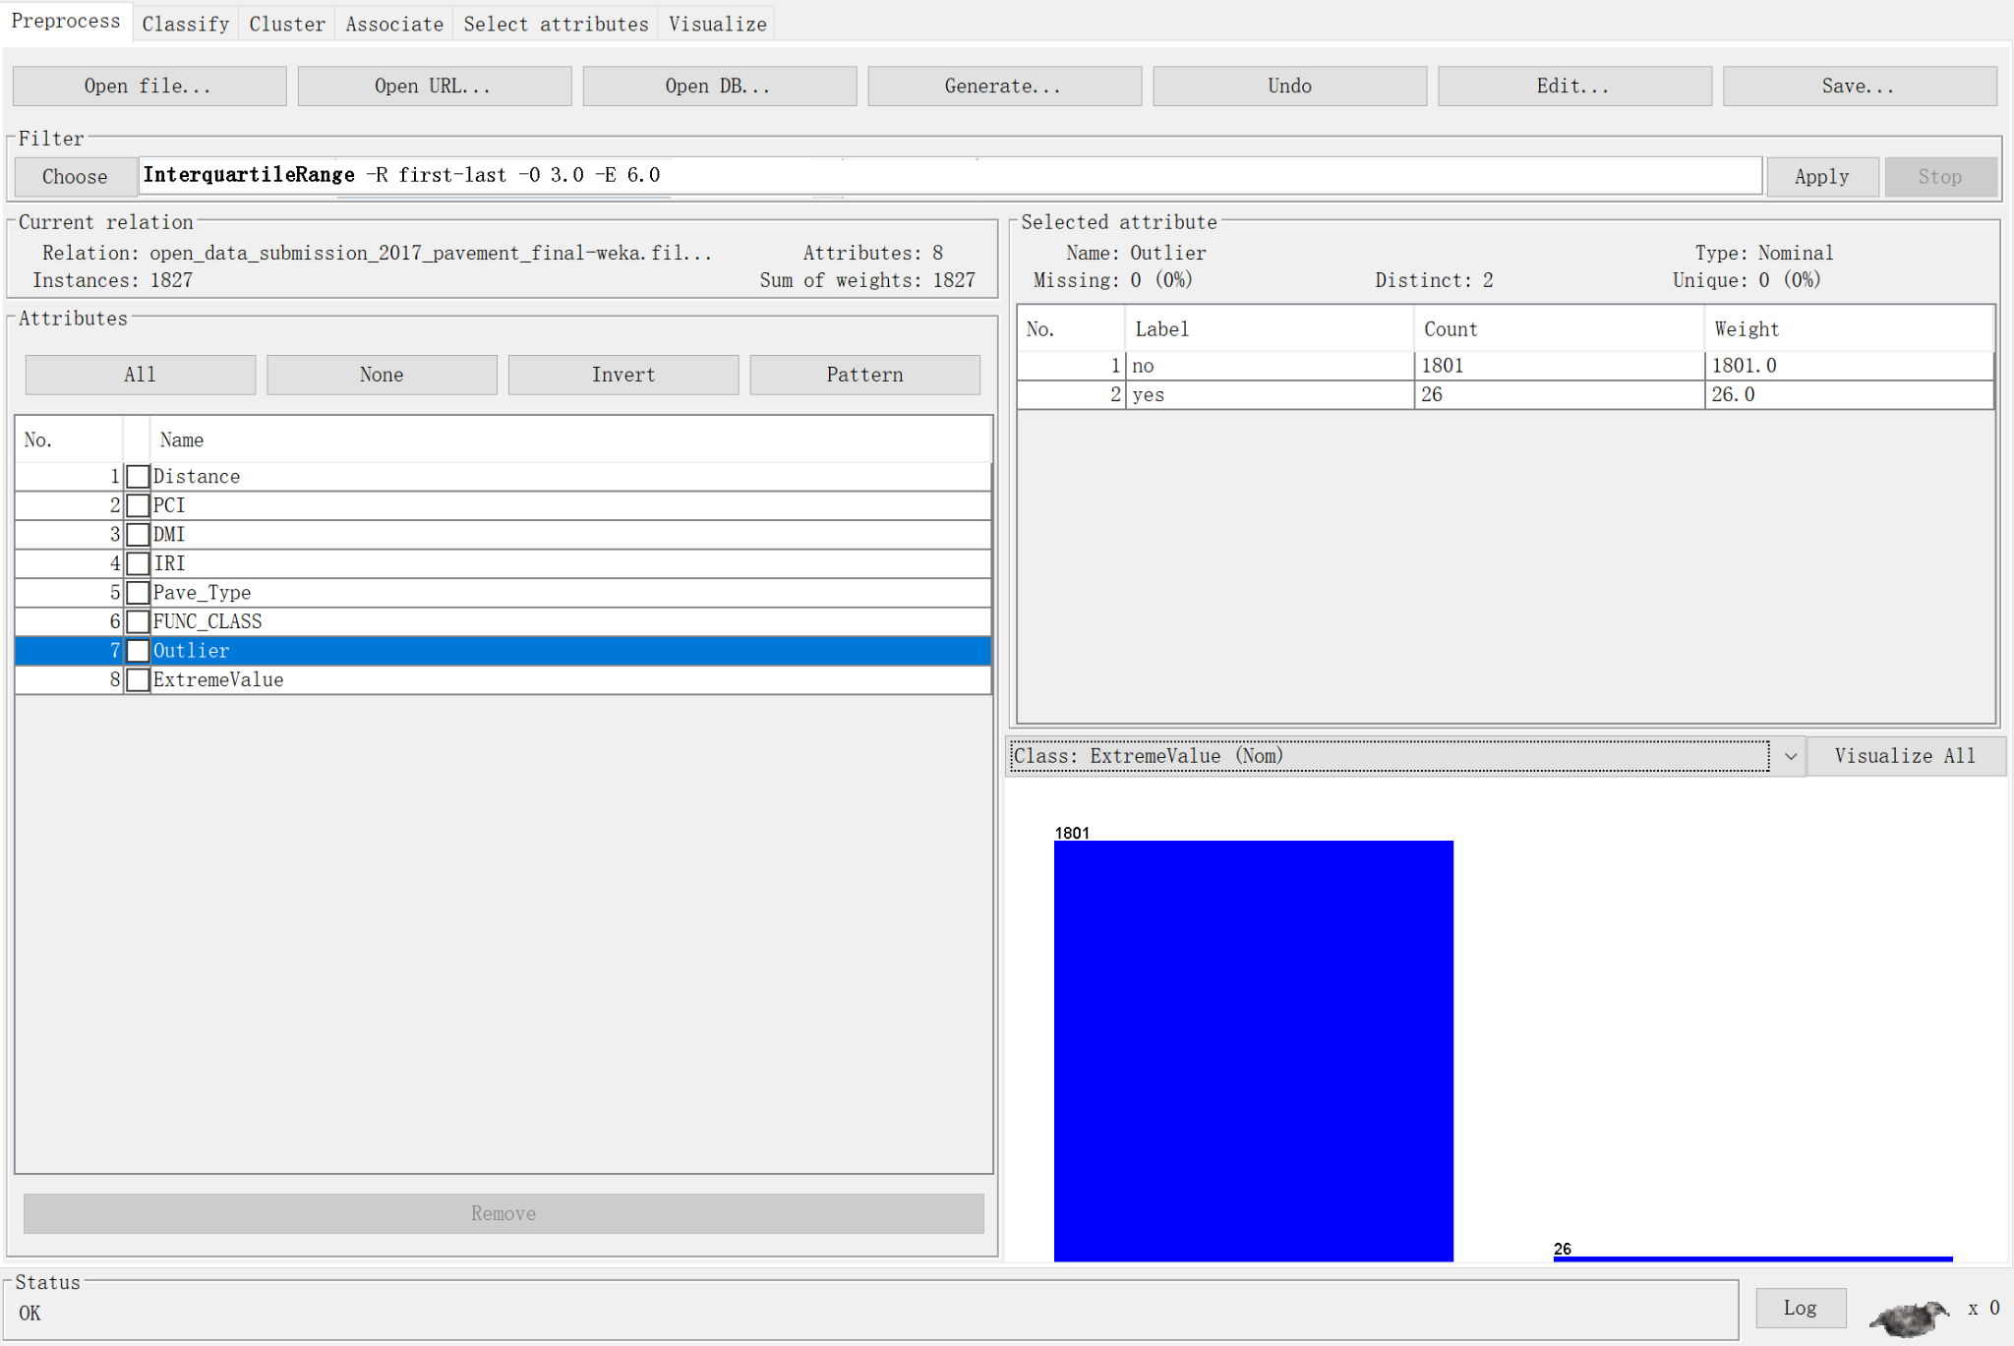
Result (Outlier)
There are 26 outliers out of 1827 instances

Slide 14
Conclusion
Distance doesn’t effect the quality of pavement
Surface-treated doesn’t have relation international roughness index & Distress Manifestation Index
IRI has the most negative influence

Slide 15
Thank you

